Slide 1
Circular Arrays
Neat trick: use a circular array to insert and remove items from a queue in constant time
The idea of a circular array is that the end of the array “wraps around” to the start of the array
7
0
6
1
5
2
4
3

Slide 2
The mod Operator
The mod operator (%) is used to calculate remainders:
  1%5 = 1, 2%5 = 2, 5%5 = 0, 8%5 = 3
mod can be used to calculate the front and back positions in a circular array, therefore avoiding comparisons to the array size
  The back of the queue is:
    (front + count - 1) % items.length
    where count is the number of items currently in the queue
  After removing an item the front of the queue is:
    (front + 1) % items.length;

Slide 3
Array Queue Example
front =
0
//Java Code
Queue q = new Queue();
q.enqueue(6);
count =
1
0
6
0
1
2
3
4
5
insert item at (front + count) % items.length

Slide 4
Array Queue Example
front =
0
//Java Code
Queue q = new Queue();
q.enqueue(6);
q.enqueue(4);
q.enqueue(7);
q.enqueue(3);
q.enqueue(8);
count =
1
2
3
4
5
6
4
7
3
8
0
1
2
3
4
5

Slide 5
Array Queue Example
front =
1
//Java Code
Queue q = new Queue();
q.enqueue(6);
q.enqueue(4);
q.enqueue(7);
q.enqueue(3);
q.enqueue(8);
q.dequeue();//front = 1
q.dequeue();//front = 2
q.enqueue(9);
2
0
count =
5
4
3
4
6
4
7
3
8
9
0
1
2
3
4
5
make front = (0 + 1) % 6 = 1
make front = (1 + 1) % 6 = 2

Slide 6
Array Queue Example
front =
2
//Java Code
Queue q = new Queue();
q.enqueue(6);
q.enqueue(4);
q.enqueue(7);
q.enqueue(3);
q.enqueue(8);
q.dequeue();//front = 1
q.dequeue();//front = 2
q.enqueue(9);
q.enqueue(5);
count =
4
5
5
7
3
8
9
0
1
2
3
4
5
insert at (front + count) % 6 = (2 + 4) % 6 = 0

Slide 7
Queue: Linked List Implementation
Removing items from the front of the queue is straightforward
But we need to insert items at the back of the queue in constant time
  So cannot traverse through the list
  By using an additional reference (and a little administration) we can keep track of the node at the back of the queue

Slide 8
List Queue Example
//Java Code
Queue q = new Queue();
q.enqueue(6);
6
front
back

Slide 9
List Queue Example
//Java Code
Queue q = new Queue();
q.enqueue(6);
q.enqueue(4);
6
front
4
back

Slide 10
List Queue Example
//Java Code
Queue q = new Queue();
q.enqueue(6);
q.enqueue(4);
q.enqueue(7);
6
front
4
back
7

Slide 11
List Queue Example
//Java Code
Queue q = new Queue();
q.enqueue(6);
q.enqueue(4);
q.enqueue(7);
q.enqueue(3);
6
front
4
back
7
3

Slide 12
List Queue Example
//Java Code
Queue q = new Queue();
q.enqueue(6);
q.enqueue(4);
q.enqueue(7);
q.enqueue(3);
q.dequeue();
6
front
4
back
7
3

Slide 13
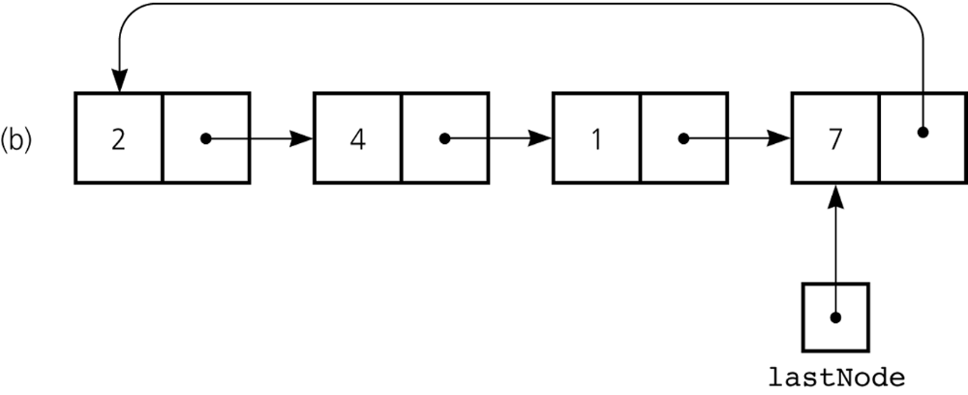
Queue: Circular Linked List Implementation
Possible implementations of a queue
  A circular linked list with one external reference
    A reference to the back
Figure 8-4b
A reference-based implementation of a queue: b) a circular linear linked list with one external reference

Slide 14
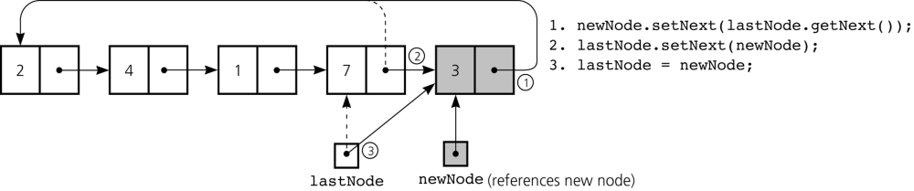
Queue: Circular Linked List Implementation
Figure 8-5
Inserting an item into a nonempty queue

Slide 15
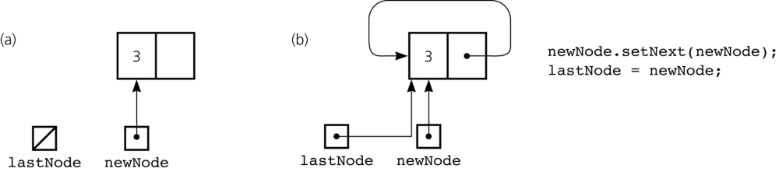
Queue: Circular Linked List Implementation
Figure 8-6
Inserting an item into an empty queue: a) before insertion; b) after insertion

Slide 16
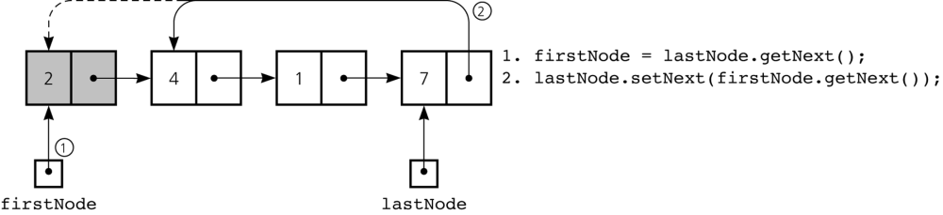
Queue: Circular Linked List Implementation
Figure 8-7
Deleting an item from a queue of more than one item

Slide 17
Queue: ADT List Implementation
public void enqueue(Object newItem) {
  list.add(list.size()+1, newItem);
  } // end enqueue
  public Object dequeue() {
  Object temp = list.get(1);
  list.remove(1);
  return temp;
  } // end dequeue
Notes:
Efficient if ADT List is implemented using an array.

Slide 18
Queue: ADT List Implementation
Efficiency depends on implementation of ADT List – in most common implementations, at least one of operations enqueue() and dequeue() is not efficient
On other hand: it was very fast to implement (code is easy, unlikely that errors were introduced when coding).

Slide 19
Application of queues: Recognizing Palindromes
A palindrome
  A string of characters that reads the same from left to right as its does from right to left
To recognize a palindrome, a queue can be used in conjunction with a stack
  A stack can be used to reverse the order of occurrences
  A queue can be used to preserve the order of occurrences

Slide 20
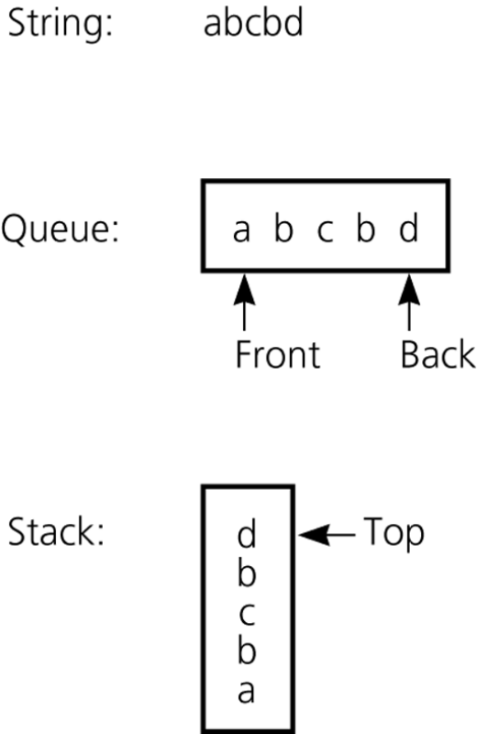
Recognizing Palindromes
A nonrecursive recognition algorithm for palindromes
  As you traverse the character string from left to right, insert each character into both a queue and a stack
  Compare the characters at the front of the queue and the top of the stack
Figure 8-3
The results of inserting a string into both a queue and a stack

Slide 21
Problems:
Recognize palindromes using 3 stacks.
Simulate (implement) a queue with 2 stacks. How efficient is this implementation?
Simulate (implement) a stack with 1 queue! (This is the problem which I wanted to discuss but didn’t recall it’s formulation exactly.) How efficient is this implementation?

Slide 22
Recursion
  An extremely powerful problem-solving technique
  Breaks a problem in smaller identical problems
  An alternative to iteration
    An iterative solution involves loops

Slide 23

Example: Rabbits
What happens if you put a pair of rabbits in a field?
  You get more rabbits!
Assume that rabbits take one month to reach maturity and that
Each pair of rabbits produces another pair of rabbits one month after mating.
That is: each pair will produce a new pair 2 months after it was born (and every month after that)

Slide 24

Example: Rabbits
How many pairs of rabbits are there after five months?
Month 1: 1 pair
Month 2: 1 pair
  after one month the rabbits are mature and can mate
Month 3: 2 pairs
  the first pair gives birth to a new pair of rabbits
Month 4: 3 pairs
  the first pair gives birth to a new pair, her first children are now mature
Month 5: 5 pairs

Slide 25

Example: Rabbits
After 5 months there are 5 pairs of rabbits
  i.e. the number of pairs at 4 months (3) plus the number of pairs at 3 months (2)
  Why?
We have count existing pairs of rabbits (the same number as previous month) + the new pairs (the same number as 2 months ago, as only those rabbits can now produce children)
This series of numbers is called the Fibonacci series
rabbit (n) = rabbit(n-1) + rabbit(n-2)

Slide 26
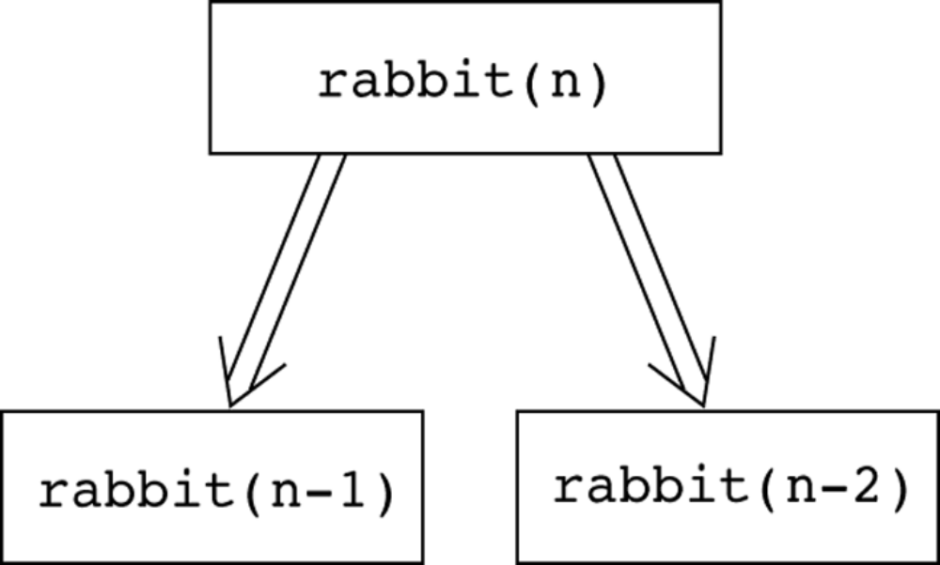
Multiplying Rabbits
(The Fibonacci Sequence)
Figure 3-10
Recursive solution to the rabbit problem

Slide 27
Fibonacci Sequence
The n^{th} number in the Fibonacci sequence, fib(n), is:
  0 if n = 0, and 1 if n = 1
  fib(n – 1) + fib(n – 2) for n > 1
So what, say, is fib(23), or how many pairs of rabbits would there be after 23 months?
  This would be easy if only we knew fib(22) and fib(21)
  If we did then the answer is just fib(22) + fib(21)
  What happens if we write a function to calculate Fibonacci numbers in this way?

Slide 28
Calculating the Fibonacci Sequence
Here is a function to return nth number in the Fibonacci sequence
  e.g. fib(1) = 1, fib(3) = 2, fib(5) = 5, fib(8) = 21, …
  public static int fib(int n){
    if(n == 0 || n == 1){
      return n;
    }
    else{
      return fib(n-1) + fib(n-2);
    }
  }
Notice this looks just like the description of the Fibonacci sequence given previously, but does it work!?
The function calls itself!!!

